Slide 1
LONG TERM INTERNSHIP ON DIGITAL MARKETING
Project Title : Flying Machine Faculty Mentor : SRINIVASA RAO Team Size : 04 STUDENTS Team Leader : ALUGU SANJAY SUMANTH - (120134207036) Team Members : TEJASWINI NANDAM(120134207039) NIHARIKA POLINATI (120134207026) MOKA LAXMAN(120134042023)

Slide 2
FLYING MACHINE
The Flying Machine descended from British band Pinkerton's Assorted Colours. Pinkerton's (as they were often known) had scored a major UK hit with "Mirror Mirror" in 1966 and continued recording over the next few years. However, by 1969, singer/guitarist Tony Newman, singer/autoharpist/original frontman Sam Kempe,[3] and bassist Stuart Colman from Pinkerton's had teamed up with lead guitarist Steve Jones and drummer Paul Wilkinson to form a new iteration of the group and, with Newman now assuming lead vocal/frontman duties, took the name The Flying Machine.[4]
They are best known for their single in 1969, "Smile a Little Smile for Me", which peaked at No. 5 on the U.S. Billboard Hot 100 chart (on Kapp Records' Congress record label) It also reached No. 6 on the AC chart. Their first LP, which was self-titled, was released by Janus Records in 1969. By 12 December that year the single had sold a million copies and was awarded a gold disc by the R.I.A.A.[5] The song was written by Tony Macaulay and Geoff Stephens.[6] Despite being released by Pye Records in the band's native UK, the record did not appear on the UK Singles Chart.
A follow-up single, a cover version of "Baby Make It Soon", first recorded by Marmalade, achieved the U.S. Hot 100 the following year.[7] A final single, "The Devil Has Possession Of Your Mind", was released, after which the Flying Machine split up.
Bassist Colman went on to a successful career as a session musician, record producer and BBC Radio disc jockey.

Slide 3
Band members
Tony Newman (born 1947, Rugby, Warwickshire, England) – lead vocals, guitars
Steve Jones (born 1946, Coventry) – lead guitars, vocals
Sam Kempe (born 1946, Rugby) – vocals (had apparently left the band by the time their first album was released, as he is not featured on the cover)
Stuart Colman (born Ian Stuart Colman, 19 December 1944, Harrogate, Yorkshire; died 19 April 2018) – bass, electric piano
Paul Wilkinson (born 1948, Coventry) – drums
Ancillary members
Edie Andrews (born 1945, Detroit, Michigan) – background vocals[5]
Mark Lansing (born 1952, USA) - guitars, sideman courtesy of Warner Bros. Records, 1969
Troy Adam Jones (birth year unknown) - guitarist, backup drummer

Slide 4
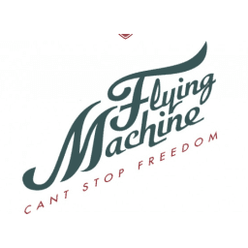
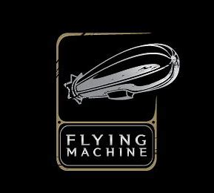

Slide 5
Competitor analysis
Arvind Limited (formerly Arvind Mills) is a textile manufacturer and the flagship company of the Lalbhai Group. Its headquarters are in Naroda, Ahmedabad, Gujarat, India, and it has units at Santej (near Kalol). The company manufactures cotton shirting, denim, knits and bottomweight (khaki) fabrics. It has also recently ventured into technical textiles with its Advanced Materials Division in 2011.[3] It is India's largest denim manufacturer.[4]
Sanjaybhai Lalbhai is the current Chairman and managing director of Arvind and Lalbhai Group. In the early 1980s, he led the 'Reno-vision' whereby the company brought denim into the domestic market, thus starting the jeans revolution in India.[5] Today it retails its own brands like Flying Machine, Newport and Excalibur and licensed international brands like Arrow, Tommy Hilfiger, and Calvin Klein through its nationwide retail network. Arvind also runs three clothing and accessories retail chains, the Arvind Store, Unlimited and Megamart, which stocks company brands.

Slide 6
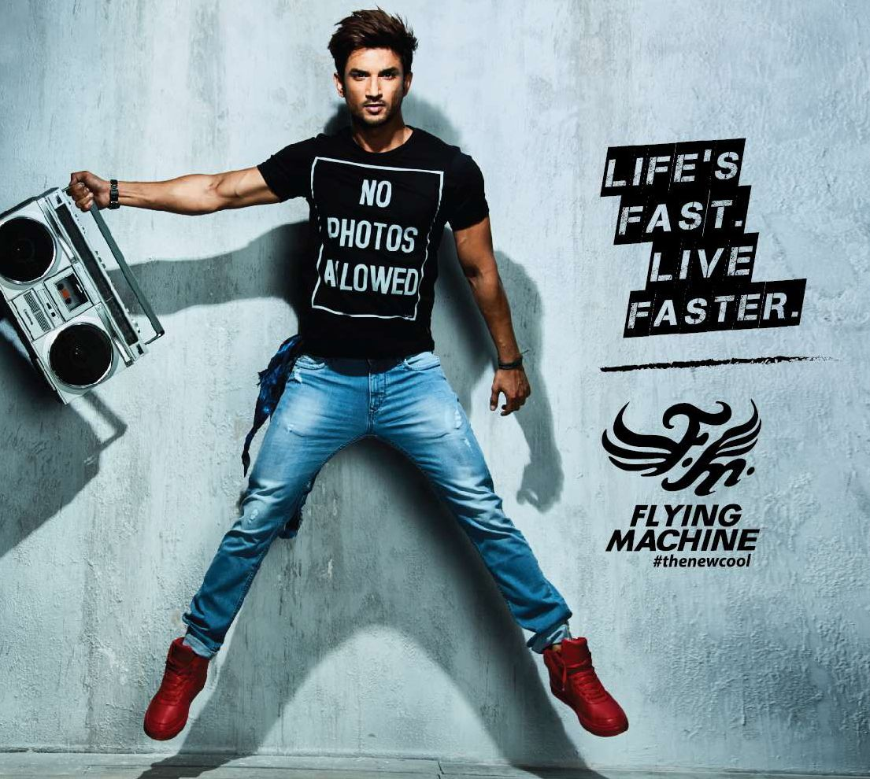

Slide 7

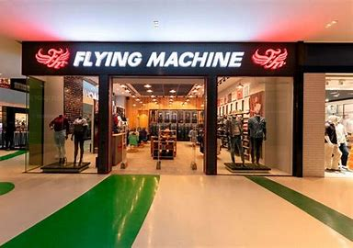
https://www.bing.com/images/search?view=detailV2&ccid=WFkKpW2t&id=22B45EEAD560B12D132BA59C846E1618FF057481&thid=OIP.WFkKpW2tpSAjY2mnRfV4PAHaEz&mediaurl=https%3a%2f%2fth.bing.com%2fth%2fid%2fR.58590aa56dada520236369a745f5783c%3frik%3dgXQF%252fxgWboScpQ%26riu%3dhttp%253a%252f%252fi.imgur.com%252fXBhRE9R.png%26ehk%3dfOo%252fxjaBrc8mjy%252bveLrgozN4LXZH8mYKNsHW5qktYwI%253d%26risl%3d%26pid%3dImgRaw%26r%3d0&exph=144&expw=222&q=Flying+Machine+Brand+Ambassador&simid=607990923832335019&FORM=IRPRST&ck=60484C5DCD2F6BA73B8F8629BC18D96B&selectedIndex=23

Slide 8
Customer buyer’s persona
The strengths of Flying Machine looks at the key internal factors of its business which gives it competitive advantage in the market and strengthens its position.
A list of strengths is mostly the starting point in a SWOT analysis. Below are the Strengths in the SWOT Analysis of Flying Machine :
1. Brand has tied up with Italian designers to get an Italian touch to Indian clothing.
2. Owns over 100 stores in India and is present in five countries abroad.
3. Belongs to the prestigious Arvind mills group which extends their brand image
4. Good advertising and brand building through ad campaigns
5. Good perception of the brand as a high quality yet affordable product

Slide 9
GROWTH
The youth have a great possession regarding brands like flying machine and brands got an extensive rate of expansion in the Indian as well as the abroad markets this had been a exclusive breach of all the other brands range The opportunities for any brand can include prospects of future growth. Following are the opportunities in Flying Machine SWOT Analysis:
1.The market for the youth segment is huge
2.Foreign market for expansion

Slide 10


Slide 11
The Flying Machine descended from British band Pinkerton's Assorted Colours. Pinkerton's (as they were often known) had scored a major UK hit with "Mirror Mirror" in 1966 and continued recording over the next few years. However, by 1969, singer/guitarist Tony Newman, singer/autoharpist/original frontman Sam Kempe,[3] and bassist Stuart Colman from Pinkerton's had teamed up with lead guitarist Steve Jones and drummer Paul Wilkinson to form a new iteration of the group and, with Newman now assuming lead vocal/frontman duties, took the name The Flying Machine.[4]
They are best known for their single in 1969, "Smile a Little Smile for Me", which peaked at No. 5 on the U.S. Billboard Hot 100 chart (on Kapp Records' Congress record label) It also reached No. 6 on the AC chart. Their first LP, which was self-titled, was released by Janus Records in 1969. By 12 December that year the single had sold a million copies and was awarded a gold disc by the R.I.A.A.[5] The song was written by Tony Macaulay and Geoff Stephens.[6] Despite being released by Pye Records in the band's native UK, the record did not appear on the UK Singles Chart.
A follow-up single, a cover version of "Baby Make It Soon", first recorded by Marmalade, achieved the U.S. Hot 100 the following year.[7] A final single, "The Devil Has Possession Of Your Mind", was released, after which the Flying Machine split up.
Bassist Colman went on to a successful career as a session musician, record producer and BBC Radio disc jockey.

Slide 12
The PROGRESSION
The strengths of Flying Machine looks at the key internal factors of its business which gives it competitive advantage in the market and strengthens its position.
A list of strengths is mostly the starting point in a SWOT analysis. Below are the Strengths in the SWOT Analysis of Flying Machine :
1. Brand has tied up with Italian designers to get an Italian touch to Indian clothing.
2. Owns over 100 stores in India and is present in five countries abroad.
3. Belongs to the prestigious Arvind mills group which extends their brand image
4. Good advertising and brand building through ad campaigns
5. Good perception of the brand as a high quality yet affordable product

Slide 13
The youth have a great possession regarding brands like flying machine and brands got an extensive rate of expansion in the Indian as well as the abroad markets this had been a exclusive breach of all the other brands range The opportunities for any brand can include prospects of future growth. Following are the opportunities in Flying Machine SWOT Analysis:
1.The market for the youth segment is huge
2.Foreign market for expansion

Slide 14
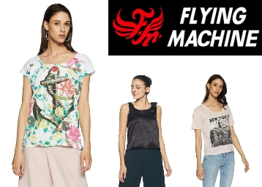
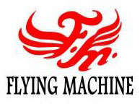

Slide 15
Band members
Tony Newman (born 1947, Rugby, Warwickshire, England) – lead vocals, guitars
Steve Jones (born 1946, Coventry) – lead guitars, vocals
Sam Kempe (born 1946, Rugby) – vocals (had apparently left the band by the time their first album was released, as he is not featured on the cover)
Stuart Colman (born Ian Stuart Colman, 19 December 1944, Harrogate, Yorkshire; died 19 April 2018) – bass, electric piano
Paul Wilkinson (born 1948, Coventry) – drums
Ancillary members
Edie Andrews (born 1945, Detroit, Michigan) – background vocals[5]
Mark Lansing (born 1952, USA) - guitars, sideman courtesy of Warner Bros. Records, 1969
Troy Adam Jones (birth year unknown) - guitarist, backup drummer

Slide 16
Flying Machine is one of the indigenously grown brands started by garment division of Arvind mills. The brand was incepted in 80’s; Flying Machine is among few early brands which started the denim category in India though consumption was pretty low. The brand had the positioning of ‘guaranteed brand’ due to its unique pricing and product innovation. However, with the growing penetration of online retail and multiple retail channels, the brand started experiencing operational huddle in managing inventory as it goes on multiple channels. Let’s shed light on same…
The Challenge
As Flying Machine began to grow, and experience increased online success, the brand realized that to continue the same growth trajectory, it needed to expand its presence across multiple marketplaces. Doing so would require more tech prowess and smart algorithms that would help in enabling a single enterprise view of inventory across multiple sales channels.

Slide 17
Ace Turtle’s omnichannel platform Rubicon enabled Flying Machine to handle increased inventory levels while simultaneously automating and optimizing catalogue across multiple marketplaces. The platform integrated all the stock points of Flying Machine and provided a single view of inventory to multiple marketplaces. With Ace Turtle, Flying Machine was able to increase its inventory significantly and expand its presence across multiple marketplaces.
The Results
Since integrating with the Rubicon platform, Flying Machine has increased its online visibility, strengthened its marketplace business and grown its sales quite significantly. Moreover, the platform allowed Flying Machine to showcase all their categories and reach out to newer marketplaces and significantly increase their sell-throughs.
Following are the few impacts that Rubicon enabled for Flying Machine from Q1 17-18 to Q4 17-18.
23 times rise in GMV
22 times rise in orders across marketplaces

Slide 18
Arvind Limited (formerly Arvind Mills) is a textile manufacturer and the flagship company of the Lalbhai Group. Its headquarters are in Naroda, Ahmedabad, Gujarat, India, and it has units at Santej (near Kalol). The company manufactures cotton shirting, denim, knits and bottomweight (khaki) fabrics. It has also recently ventured into technical textiles with its Advanced Materials Division in 2011. It is India's largest denim manufacturer.
Sanjaybhai Lalbhai is the current Chairman and managing director of Arvind and Lalbhai Group. In the early 1980s, he led the 'Reno-vision' whereby the company brought denim into the domestic market, thus starting the jeans revolution in India Today it retails its own brands like Flying Machine, Newport and Excalibur and licensed international brands like Arrow, Tommy Hilfiger, and Calvin Klein through its nationwide retail network. Arvind also runs three clothing and accessories retail chains, the Arvind Store, Unlimited and Megamart, which stocks company brands.

Slide 19
Flying Machine is one of the indigenously grown brands started by garment division of Arvind mills. The brand was incepted in 80’s; Flying Machine is among few early brands which started the denim category in India though consumption was pretty low. The brand had the positioning of ‘guaranteed brand’ due to its unique pricing and product innovation. However, with the growing penetration of online retail and multiple retail channels, the brand started experiencing operational huddle in managing inventory as it goes on multiple channels. Let’s shed light on same…
The Challenge
As Flying Machine began to grow, and experience increased online success, the brand realized that to continue the same growth trajectory, it needed to expand its presence across multiple marketplaces. Doing so would require more tech prowess and smart algorithms that would help in enabling a single enterprise view of inventory across multiple sales channels

Slide 20
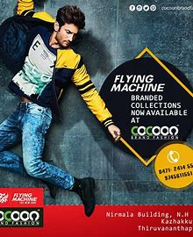

Slide 21
Ace Turtle’s omnichannel platform Rubicon enabled Flying Machine to handle increased inventory levels while simultaneously automating and optimizing catalogue across multiple marketplaces. The platform integrated all the stock points of Flying Machine and provided a single view of inventory to multiple marketplaces. With Ace Turtle, Flying Machine was able to increase its inventory significantly and expand its presence across multiple marketplaces.
The Results
Since integrating with the Rubicon platform, Flying Machine has increased its online visibility, strengthened its marketplace business and grown its sales quite significantly. Moreover, the platform allowed Flying Machine to showcase all their categories and reach out to newer marketplaces and significantly increase their sell-throughs.
Following are the few impacts that Rubicon enabled for Flying Machine from Q1 17-18 to Q4 17-18.
23 times rise in GMV
22 times rise in orders across marketplaces

Slide 22
SREACH ENGINE OPTIMIZATION
THE SEARCH ENGINE OPTIMIZATION IN FLYING MACHINE CONSISTS OF MANY VULNERABLES INCLUDING THE PROMOTION OF THE BRAND SEARCH AND ALSO THE PROMOTING STAT OF THE BWAND ON THE FRONT LINE OF THE BASE . THE FLYING MACHINE HAD MADE ITS BRAND STAG IN THE INDIAN INDUSTRY BY ALL THE MEANS OF AUDICITY.
The Results
Since integrating with the Rubicon platform, Flying Machine has increased its online visibility, strengthened its marketplace business and grown its sales quite significantly. Moreover, the platform allowed Flying Machine to showcase all their categories and reach out to newer marketplaces and significantly increase their sell-throughs.
Following are the few impacts that Rubicon enabled for Flying Machine from Q1 17-18 to Q4 17-18.
23 times rise in GMV
22 times rise in orders across marketplaces

Slide 23
Financial restructuring[edit]
In the mid-1990s, the company undertook a massive expansion of its denim capacity even though other cotton fabrics were slowly replacing the demand for denim. The expansion plan was funded by loans from both Indian and overseas financial institutions. With the demand for denim slowing, the company found it difficult to repay the loans, resulting in an increased interest burden on the loans. In the late 1990s, the company encountered financial problems due of its debt burden, resulting in incurring significant losses.^{[14]}
The company came up with a debt-restructuring plan for the long-term debts being taken up in February 2001. This complex financial restructuring exercise, which involved several domestic and international lenders, is considered to be the benchmark and a case study in India. The restructuring was overseen by Jayesh Shah, CFO, and advised on by a JP Morgan Hong Kong team, led by Ahmad Ayaz.

Slide 24
In 2018, Arvind Ltd. demerged its branded apparel and engineering business into separate entities for enhanced focus and value addition for the shareholders of the Company. It got the nod from NCLT Ahmedabad bench for demerger in Oct 2018.^{[15]} Arvind Fashions, the branded apparel entity, will be scaling up existing brand portfolio and improve profitability across brands.^{[16]} Anveshan Heavy Engineering, earlier known as Anup Engineering, has laid down capex plans of ₹80 crore to double existing fabrication capacity of 15,000 tonnes per annum by implementing product mix. Out of the planned investment, ₹40 crore has already been invested.

Slide 25


Slide 26
THE CONTENT IDEAS
THE COMING ERA OF FKYING MACHINE
2018, Arvind Ltd. demerged its branded apparel and engineering business into separate entities for enhanced focus and value addition for the shareholders of the Company. It got the nod from NCLT Ahmedabad bench for demerger in Oct 2018.^{[15]} Arvind Fashions, the branded apparel entity, will be scaling up existing brand portfolio and improve profitability across brands.^{[16]} Anveshan Heavy Engineering, earlier known as Anup Engineering, has laid down capex plans of ₹80 crore to double existing fabrication capacity of 15,000 tonnes per annum by implementing product mix. Out of the planned investment, ₹40 crore has already been invested.

Slide 27
Kasturbhai Lalbhai (19 December 1894 – 20 January 1980) was an Indian industrialist and philanthropist. He co-founded the Arvind Mills along with his brothers and several other institutes. He was a cofounder of the Ahmadabad Education Society which initiated Ahmedabad University and the Indian Institute of Management Ahmedabad. He served as the chairman of historic and influential Anandji Kalyanji Trust that manages Shatrunjaya and several other Jain pilgrimage centers, for 50 years.

Slide 28
Band members
Tony Newman (born 1947, Rugby, Warwickshire, England) – lead vocals, guitars
Steve Jones (born 1946, Coventry) – lead guitars, vocals
Sam Kempe (born 1946, Rugby) – vocals (had apparently left the band by the time their first album was released, as he is not featured on the cover)
Stuart Colman (born Ian Stuart Colman, 19 December 1944, Harrogate, Yorkshire; died 19 April 2018) – bass, electric piano
Paul Wilkinson (born 1948, Coventry) – drums
Ancillary members
Edie Andrews (born 1945, Detroit, Michigan) – background vocals[5]
Mark Lansing (born 1952, USA) - guitars, sideman courtesy of Warner Bros. Records, 1969
Troy Adam Jones (birth year unknown) - guitarist, backup drummer

Slide 29
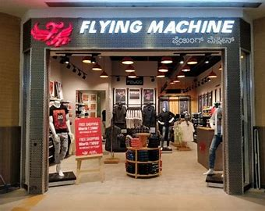
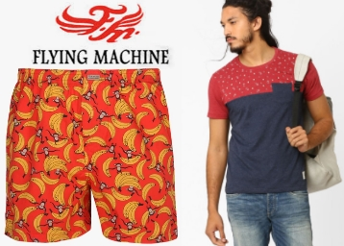

Slide 30
1897: Arvind Mills starts a business for sarees.
1931: Arvind Mills Ltd is incorporated by three brothers Kasturbhai, Narottambhai and Chimanbhai.^{[8]} with a share capital of ₹165,000 ($2500) in Ahmedabad. The products manufactured are dhoties, sarees, mulls, dorias, crepes, shirtings, lingerie, coatings, printed lawns and voiles cambrics, twills and gaberdine.
1934: Becomes established as the foremost textile units in the country.^{[8]}
1985: Diversified into electronics by setting up a plant to manufacture electronic telephone exchanges (EPABX) and also entering into marketing pharmaceutical products and B&W and colour television sets under the name Pyramid.^{[8]}
1986: Becomes first company in India bring globally accepted fabrics such as Denim yarn dyed shirting fabrics & wrinkle free gabardines

Slide 31
1987: The company takes up a modernisation program to triple the production of denim cloth and to produce double yarn fabrics for exports. The new product groups identified are: indigo dyed blue denim and high quality two-ply fabrics for exports, and products such as butta sarees, full voiles and dhoties. Also started retail outlets for 'Arrow' brand and became the first company in India to bring international shirt brand 'Arrow'.^{[8]}
1991: Arvind reaches 100 million meters of denim per year, becoming the fourth-largest producer of denim in the world.
1992: The company increases production of denim cloth by 23,000 tonnes per day by modernising the plant at Khatraj of Ankur Textiles.
1994: The company's operations are divided into textile, telecom and garments divisions.
1995: The garment division launches ready to stitch jeans pack under the brand Ruf & Tuf.
1997: The marketing and distribution network of the Newport brand is strengthened and the relaunched Flying Machine and Ruggers brands were strengthened.

Slide 32
CPNTENT CREATION
Arvind Mills sets up an anti-piracy cell for the first time in India to curb large scale counterfeiting of their brands Ruf & Tuf and Newport jeans. Arvind Mills adopts the franchisee system for manufacturing and distribution of Ruf & Tuf jeans.rvind Fashions doubles capacity at thAe Bangalore manufacturing facility to produce Lee jeans.
Arvind Mills emerges as the world's third largest manufacturer of denim.
Arvind Mills goes live with SAP R/3 ERP package in April 1997 in their new manufacturing units.
increases the number of Spindles and Stitching Machines by 2036 Nos and 38 Nos respectively.^{[8]}
For the fourth quarter, Arvind Mills saw a 280% growth in net profit.
Arvind Mills Ltd is assigned a "P1+" rating by CRISIL, which indicates a very strong rating for their commercial paper.
Increases the number of Stitching machines by 7 Nos.^{[8]}
Expanded their shirts manufacturing capacity from 2.4 million pieces to 4.8 million pieces per .] Its s company Arvind Spinning Ltd commences its operation.^{[8]}
For the fourth quarter in a row, Arvind Mills posts a profit growth in excess of 80%. Arvind Mills buys the entire stake in Arvind Brands from ICICI Ventures.
commenced their operations of producing Jeans Pant in Bangalore with the installed capacity of 4 million Pcs per annum from March.^{[8]}

Slide 33
New Denim collection was launched aimed at Super Premium brands of US, Europe, Japan and Korea. Also opened new venues for the Denim division as response to this collection was good.
April: Demerge and transfer of the Garments Business Division to their 100% subsidiary company Arvind Brands Ltd and amalgamating Arvind Fashions Ltd a 100% subsidiary of Arvind Brands Ltd with Arvind Mills ] Joint venture with company Arvind Murjani Brand Pvt Ltd through which they hold license to sell Tommy Hilfiger brand apparel in India August: Wholesale branded apparel business of Arvind Fashions Ltd sold to VF Arvind Brands Pvt Ltd.
Arvind expands its presence in the retail segment by establishing MegaMart, one of India's largest value retail chains.
From March, company signs an exclusive license agreement with Philips-Van Heusen Corporation (PVH) for designing, distribution and retailing of IZOD brand apparels in India: Company's name changed from Arvind launches "Arvind Store", a concept showcasing the company's best fabrics, brands and bespoke styling and tailoring solutions under one roof.
September: Sets up a 30 million meters of denim manufacturing plant in Bangladesh with a total investment of $60 million in joint venture with Nitol group where the latter will have 20% stake in the joint venture company.
Arvind launches its first major real estate project.

Slide 34
We are India's first home bred jeans brand, owned by Arvind mills' garments division. Born in the year 1980, we were considered a cult for the next 10 years. It's really hard to find a fashion conscious male from that time in India who did not wear denims made by us. Launched in 1980, at a time when only smuggled jeans were available.
Cornered substantial market with innovations of Indian fit, a 'guaranteed brand' available at a decent price. By 1994 it had become a leader in branded jeans in India and is still seen as trendy and premium.

Slide 35
Innovation and Sustainability are a way of life at Arvind Denim, and a large number of global rewards received each year are testimony of our commitment to it. We pride ourselves on technologies such as Neo, wash techniques that reduce water consumption, and sustainable fibres that make us one of the most responsible denim producers in the world.
Arvind Denim’s strength is reflected in our propriety innovative products such as Azurite, and brands like BOOMERANG™ that enjoy consumer level co-branding.
We collaborate with village industries on truly hand spun and handloom woven Denim products that help us preserve our heritage crafts and support thousands of livelihoods.

Slide 36

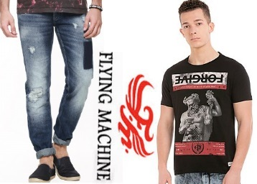

Slide 37
We are a one stop shop facility, a trusted name worldwide to deliver creative and high quality fashion concepts in Formal and Casual Shirts, Tops & Dresses, Trousers and Jackets across Color Wovens, Indigo, Solid and Print categories
Our Arvind Innovation Lab is a state of the art facility that continuously designs and develops path breaking responsible innovation, giving life and performance to fashion ensembles such as Bluetech, Superdoux, Sprint & Aizome protecting our customers with our patents and trademarks.
We have a global presence, driven by an international team of textile technologists, design experts and retail specialists. These experts collaborate and co-create fashion solutions such as Banana Republic

Slide 38
From trademark performance concepts such as Commuter 5-Pocket and Shrink-to-fit of Levi’s to Banana Republic’s Rapid movement Chino that’s about technological uniqueness, handling complex yarns and imparting varied functionalitiesand Monogram Formal Suits, we are creating seasonal fashion to timeless classics in Jeanswear, sportswear and Formal category for our brand partners. Arvind Innovation lab drives a constant flow of inspiration and ideas that shape global Khakhi culture.

Slide 39
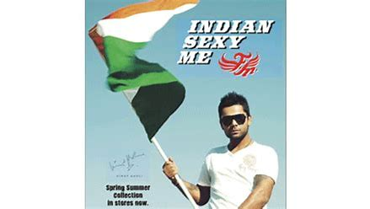
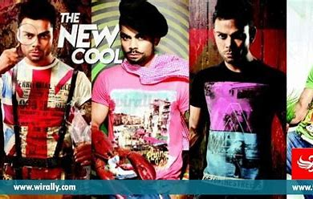

Slide 40
In addition to its climate change, the fashion business has a big impact on landfill trash, water pollution, and soil erosion. While the majority of discussions and circular fashion strategies concentrate on the issue of worn clothing—post-consumer waste, less consideration is given to textile waste and residues from the clothing production process (pre-consumer waste). Because we produce textiles, we are ideally situated to handle pre-consumer waste. Our initiatives for circular fashion includes:
Allocation of R&D resources towards circular fashion and collaboration with cross industry platforms like Fashion for Good, Cradle to Cradle and Jeans Redesign.
Program like establishing a garneting unit and signing partnerships with Purfi to reduce, recycle or reuse unsold goods in order to avoid their destruction.
Continuous engagement with brands i.e. our customers on how to produce textile more sustainably and make them last longer

Slide 41
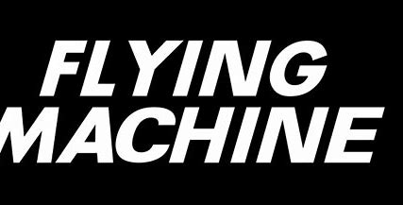
Natural systems are dynamic and there is often a delay between taking action and seeing a measurable change. Without measurement of actions it is difficult to understand the effectiveness of our strategies for biodiversity management. Our actions for compliance and monitoring include:
Engagement with suppliers and/or partners to manage and mitigate deforestation risks
Group-wide compliance with forest regulations and/or mandatory standards
Measuring our performance as per the indicators set forward in the biodiversity strategy
The targets, its description, indicator used for measurement and its relevance to various pressure drivers is detailed in our Biodiversity Strategy. For performance of the targets refer to Evaluating our Progress

